Slide 1
Internally Displaced Persons
Shattered in the shadows

Slide 2
Contents
Introduction
Causes of Displacement
Survey Report
Recommendations
Conclusion

Slide 3
Introduction
IDPs are people who have to leave their homes but stay within their country.
They aren’t like refugees because they don’t cross into other countries.

Slide 4
Causes of Displacement
Conflict and Violence
Ethnic & Religious Persecution
Militarization
Natural Disaster
Political Instability

Slide 5

Political Instability
Conflicts between the government and separatist groups, causes displacement in Pakistan.

Slide 6
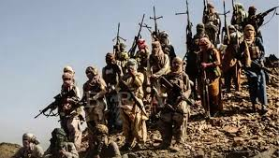
Case Studies
a) Balochistan Insurgency
Balochistan has rich resources but local groups feel neglected.
Groups like BLA fought the government

Slide 7
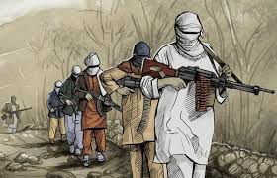
b) FATA and Pashtun Separatism
Conflict between Pashtun tribes, TTP, and the military caused large-scale displacement.
Military operations like Operation Zarb-e-Azb forced people to flee.

Slide 8

Governments Response
Temporary Camps: Provided food, water, and shelter for IDPs.
Rehabilitation Programs: Worked with international organizations to rebuild homes.

Slide 9

Development Projects: Investments like CPEC aimed at stabilizing the region.
Security Operations: Military worked to control areas and help families return.

Slide 11
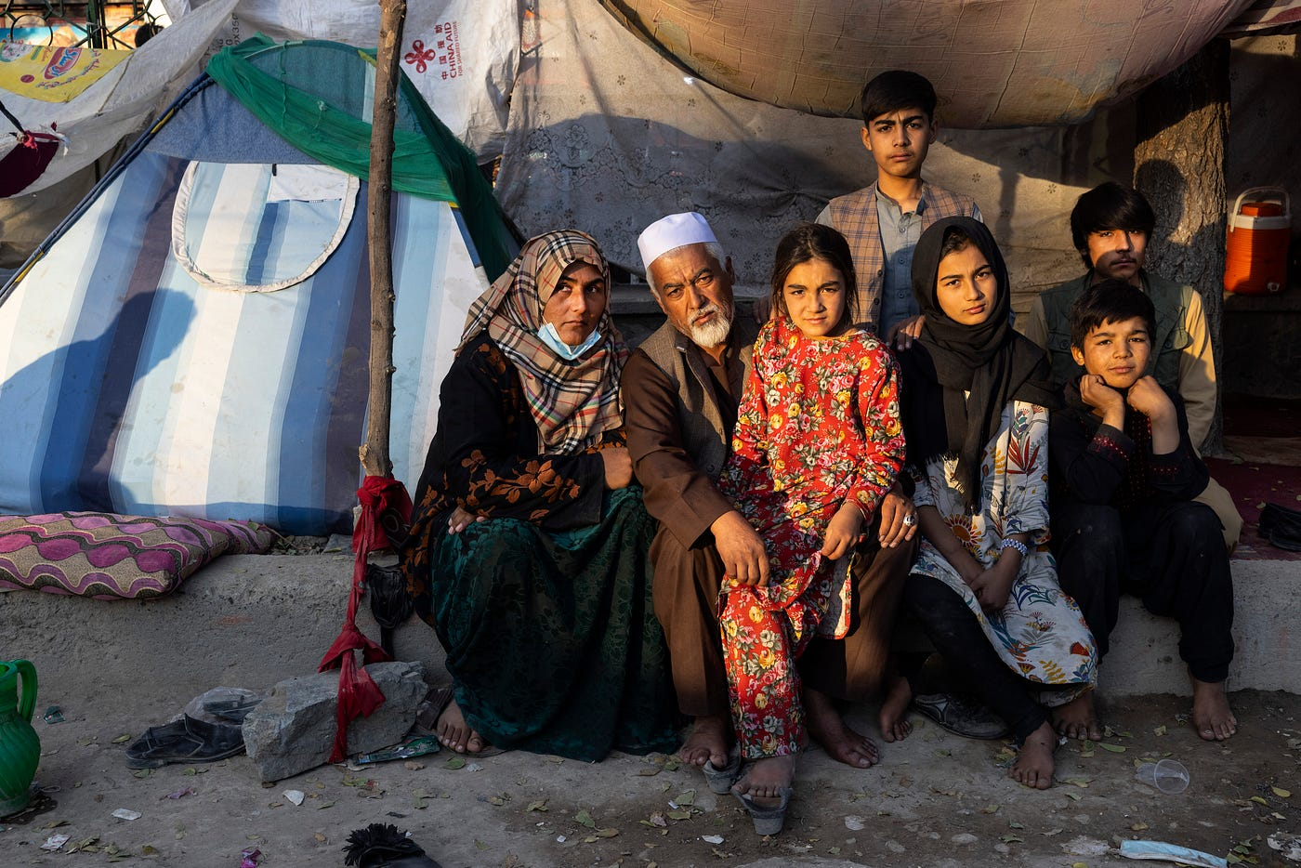
Recommendations
Faster Rehabilitation: Rebuild homes and infrastructure quickly.
Better Camp Conditions: Improve food, water, and education in camps.

Slide 12

Sustainable Job Projects: Programs to assist IDPs in recapturing financial strength.
International Participation: Coordinated effort between state and NGOs

Slide 13
Conclusion
IDPs are a key issue in our community, needing urgent support.
They struggle to access essentials like food and shelter.
Assisting IDPs strengthens both them and our community.

